Slide 1




Water Level Indicator
EEE 304 – Digital Electronics Laboratory
July 2023 Level – 3 Term – 2
Final Project Demonstration
Submitted by – Group 08
Md Hasan Newaz
1906135
Md. Asif Kabir
1906153
Tamim Hasan Bhuiyan
1906154
Md. Shipon Hossain
1906155

Slide 2
Outline
Summary
Introduction
Design
Implementation
Analysis and Evaluation
References

Slide 3

1.Abstract
Innovative solution for water level monitoring.
Addresses water management needs in various sectors.
Utilizes electronic sensors
Provides real-time data via a 7-segment display.
Includes an audible alert mechanism for overflow prevention.

Slide 4
2. Introduction
Highlighting the problem: Inefficient water level monitoring.
Emphasizing the critical nature of the issue.
Stating the need for a reliable and user-friendly solution.
Mentioning the consequences of inadequate monitoring, such as overflow and damage.

Slide 5
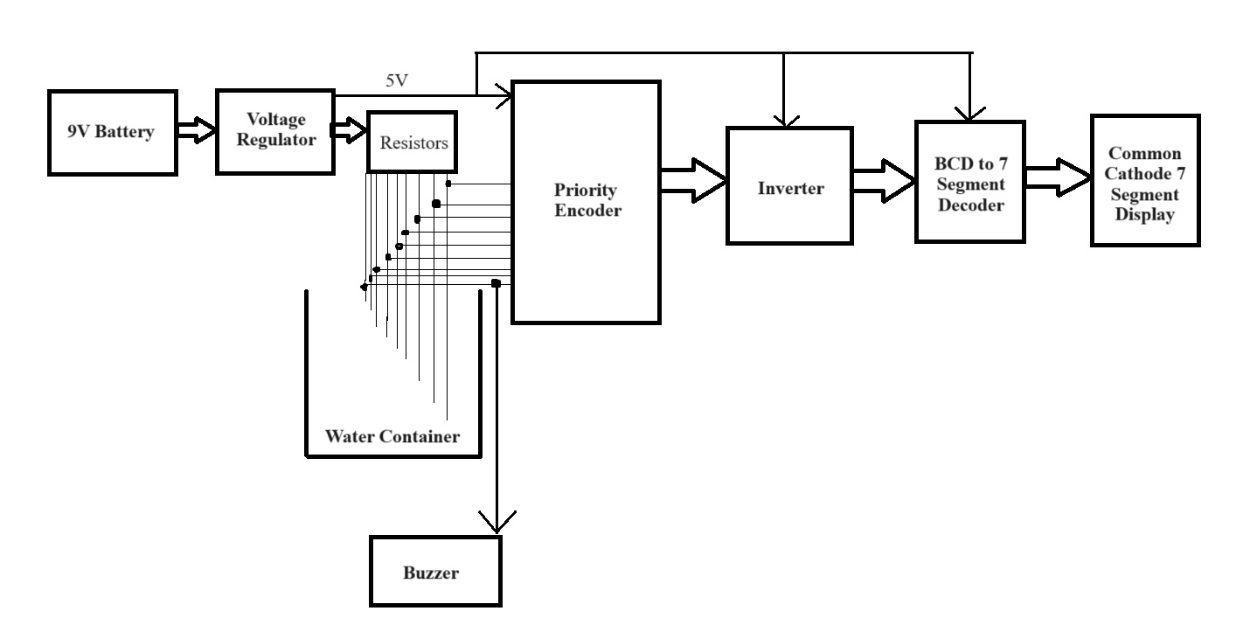
3.1 Design: Methods

Slide 6
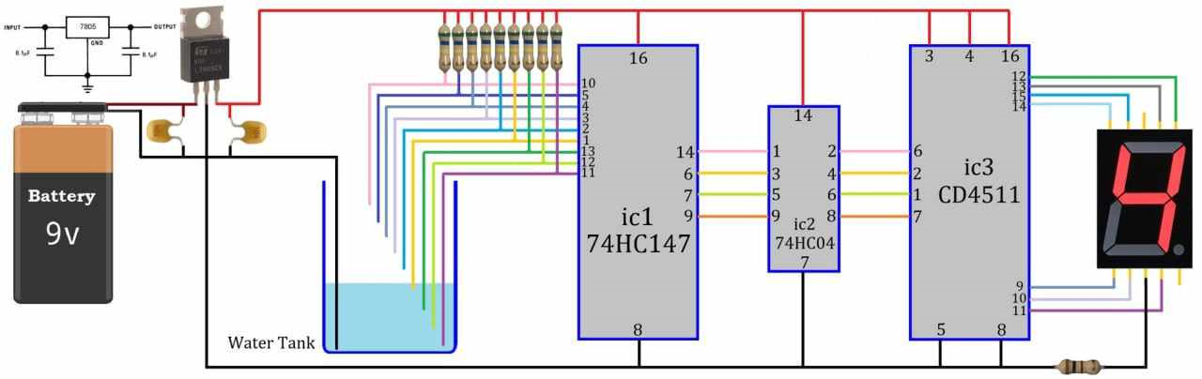
3.2 Design: Circuit Diagram

Slide 7
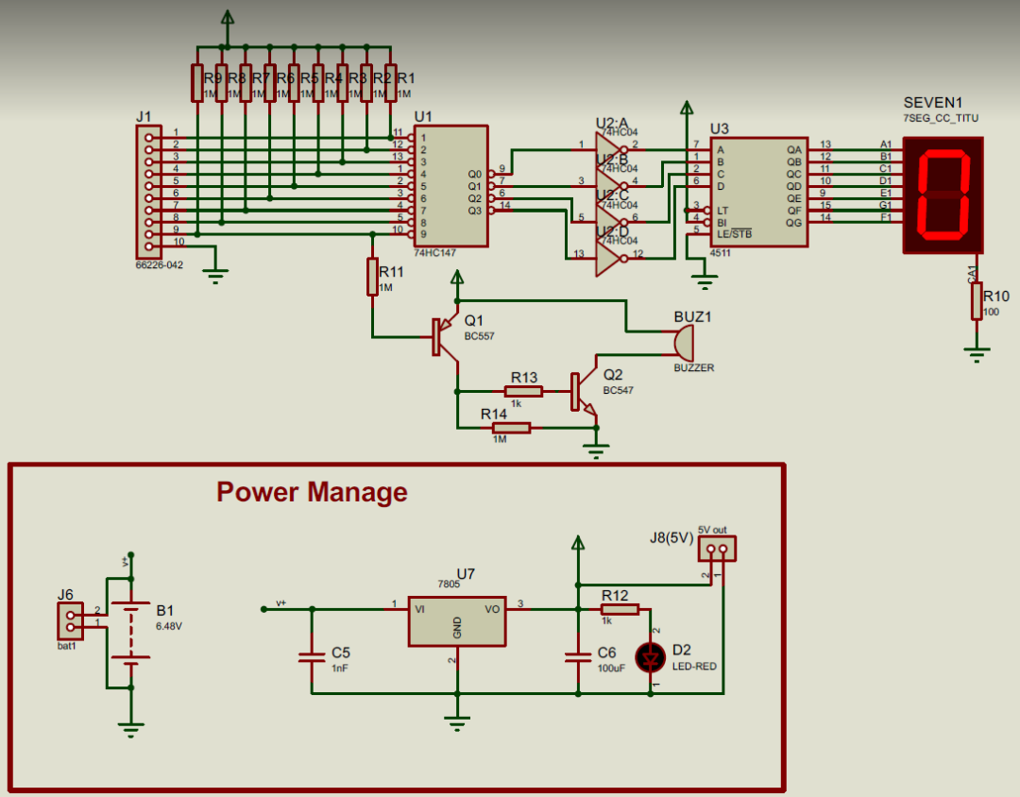
3.3 Design: Simulation

Slide 8
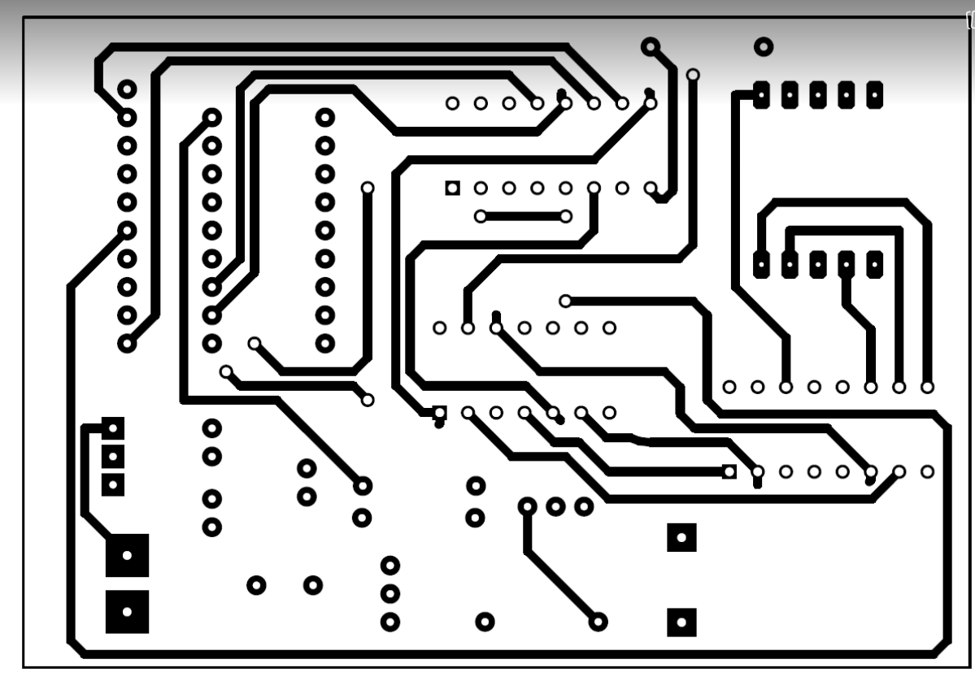
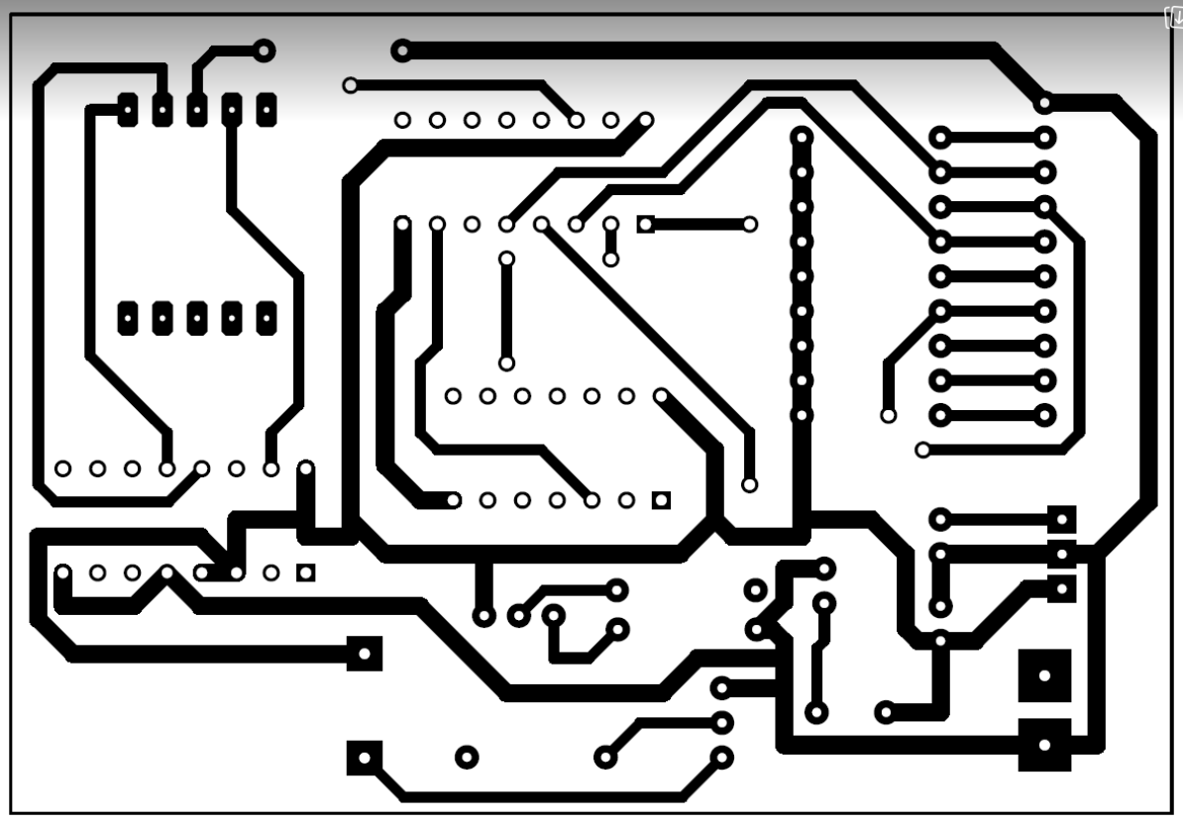
3.4 Design: PCB Layout
Fig: Top Copper
Fig: Bottom Copper

Slide 9
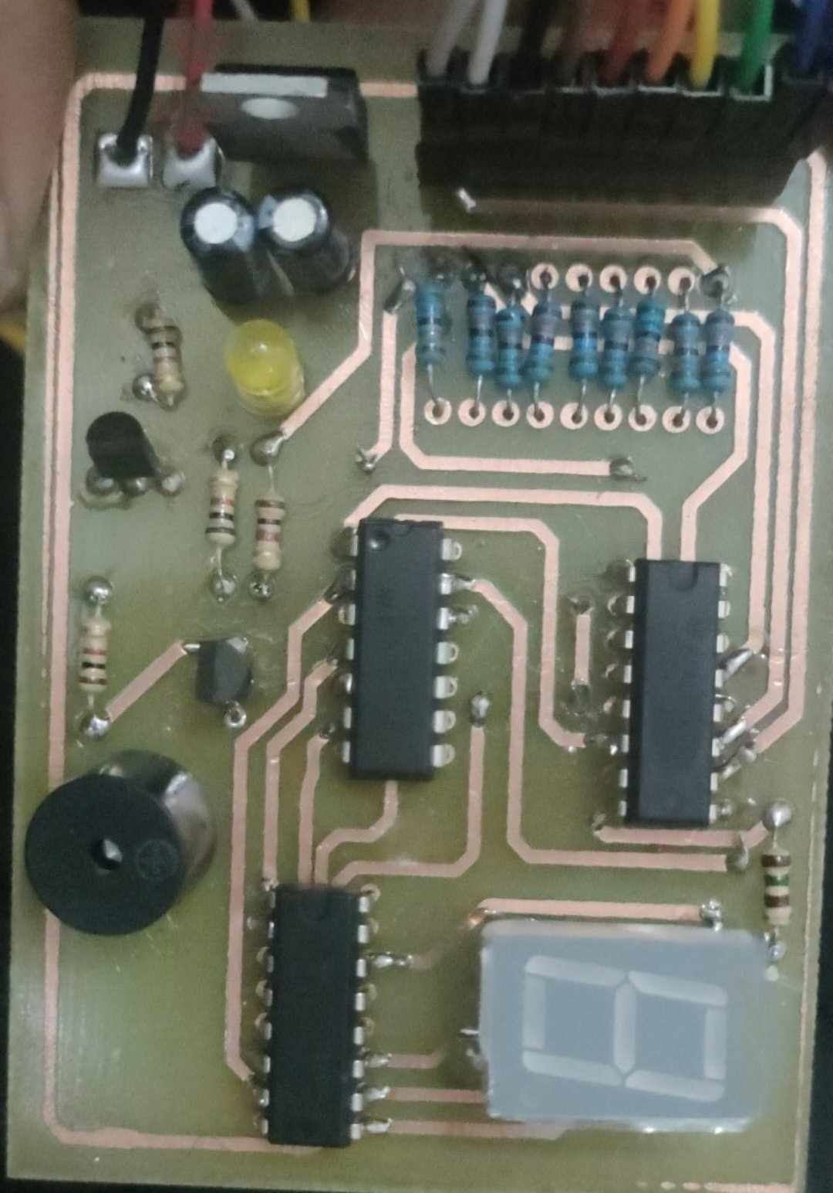
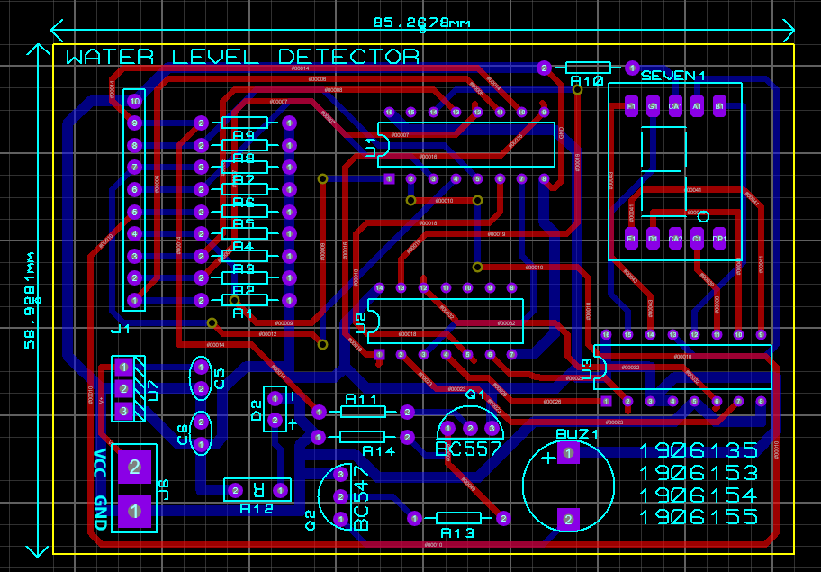
3.4 Design: PCB Layout
Fig: Top Silk
Fig: PCB Board with Components Connected

Slide 10
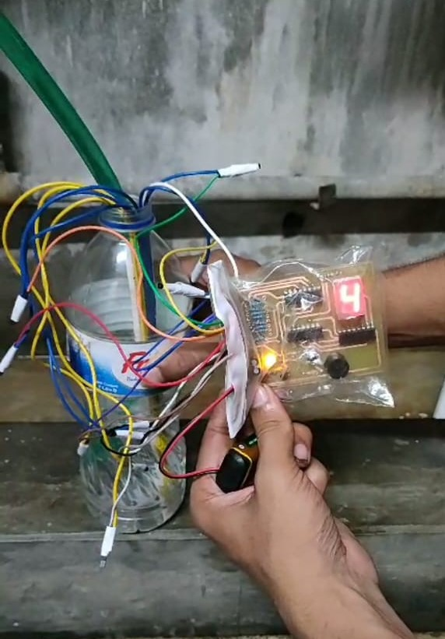
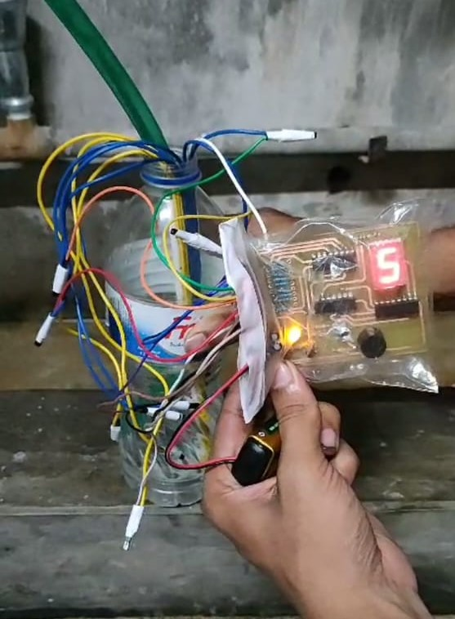
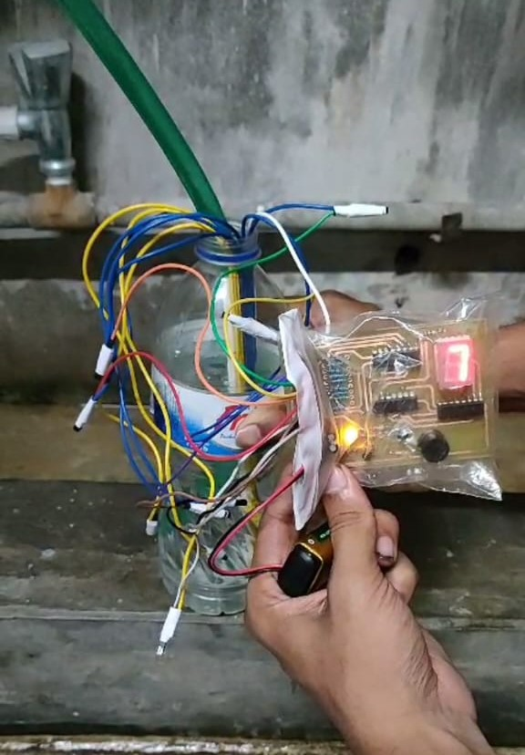
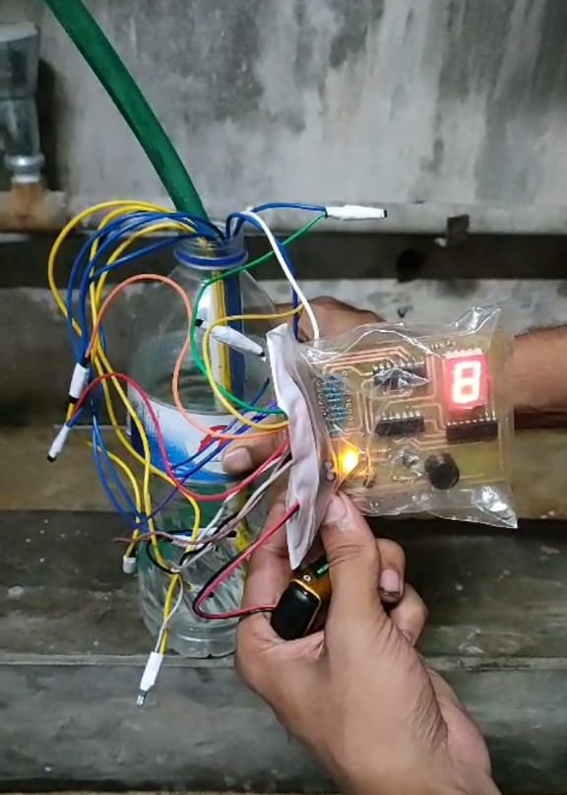
4 Implementation: Demonstration

Slide 11
5.1 Novelty
Real-Time Monitoring
7-Segment Display
Audible Alert

Slide 12
5.2 Project Management and Cost Analysis
Components | Quantities | Price
9V Battery + Battery Clip | 1 piece | 60 Tk.
Voltage Regulator (7805) | 1 piece | 10 Tk.
Capacitors (0.1 µF) | 2 pieces | 8 Tk.
Resistors (570 kΩ) | 9 pieces | 9 Tk.
Resistor (100 Ω) | 1 piece | 1 Tk.
Resistors (1 kΩ) | 2 pieces | 2 Tk.
Priority Encoder (74HC147) | 1 piece | 40 Tk.
Hex Inverter (74HC04) | 1 piece | 20 Tk.
BCD to 7 Segment Decoder (CD4511) | 1 piece | 25 Tk.
Common Cathode 7 Segment Display | 1 piece | 10 Tk.
BJT (BC547, BC557) | 2 pieces | 10 Tk.
Buzzer | 1 piece | 20 Tk.
DC Lamp | 1 piece | 20Tk
Push Button | 3 pieces | 15 Tk.
Breadboard | 2 pieces | 130 Tk.
PCB Board | 1 piece | 100 Tk
Jumpper Wire | 1 box | 65 Tk.
Jumpper Connectors |  | 35 Tk.
Header Pin | 40 pieces | 40 Tk.
Total |  | 495Tk

Slide 13
5.3 Practical Considerations of the Design
Overflow Prevention
Buzzer Alert
Energy Efficiency
Material Selection
User-Friendly Interface
Customizable Alerts

Slide 14
5.4 Applications
Water Level Indicator
Ebb and Tide Detection in Costal Area
Flood Predictor
Dam Control in Hydro-electric Plant

Slide 15
5.5 Features
Wireless Connectivity
Data Logging and Analytics
Advanced Alerting
Multiple Container Monitoring
Energy Efficiency
Water Metering System
Mobile Application Development

Slide 16
6.1 Individual Contribution of Each Member
1906135: Component management, Circuit implementation.
1906153: Planning and Schematic diagram design.
1906154: Circuit building in breadboard and testing.
1906155: PCB design and connection.

Slide 17
6.2 Logbook of Project
Date | Milestone achieved | Individual Role | Comments
08-08-23 | Planning and schematic | 1906153 | Successfully done
12-08-23 | Buying components | 1906154, 1906135 | Successfully done
20-08-23 | Circuit Building | 1906153-154 | Successfully done
30-08-23 | PCB Design | 1906155 | Successfully done
04-09-23 | PCB circuit connection | 1906135 | Successfully done
07-09-23 | Main circuit design and Testing | 1906154, 1906135 | Successfully done

Slide 18
7. References
https://lamintang.org/journal/index.php/ijortas/article/view/59
https://ascelibrary.org/doi/abs/10.1061/(ASCE)0733-9437(1999)125%3A4(189)
https://www.researchgate.net/publication/360614196_A_Review_of_an_Automatic_Water_Level_Indicator
https://github.com/embeddedlab786/Dig...

